Slide 1
Chapter 5
Learning without supervision

Slide 2
Unsupervised learning
Consider the problem of word sense disambiguation were a word can have different sensed or meanings.
The goal is to classify each instance of a word into a sense.
Question:
If the labels are missing from our dataset, Is it possible to learn anything about these different senses without labeled data?

Slide 3
Unsupervised learning
Question:
If the labels are missing from our dataset, Is it possible to learn anything about these different senses without labeled data?
Solution:
Clustering algorithms are capable of finding different context groups. These algorithms assign each data point to a discrete cluster or category, zi ∈ 1, 2, . . . K.

Slide 4
K-means clustering
K-means is an iterative algorithm that maintains a cluster assignment for each instance, and a central (“mean”) location for each cluster.
K-means iterates between updates to the assignments and the centers:
Each instance is placed in the cluster with the closest center.
Each center is recomputed as the average over points in the cluster.
In K-means, the converged solution depends on the initialization, and a better clustering can sometimes be found simply by re-running the algorithm from a different random starting point.

Slide 5
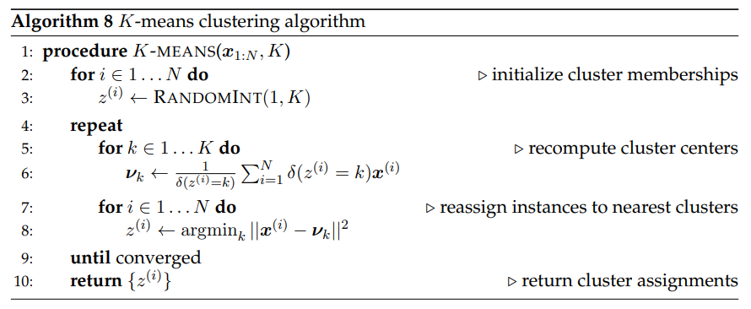
K-means clustering pt2

Slide 6

Soft K-means
Soft K-means is a particularly relevant variant. Instead of directly assigning each point to a specific cluster, soft K-means assigns to each point a distribution over clusters.
The soft weight qi(k) is computed from the distance of xi to the cluster center νk. In turn, the center of each cluster is computed from a weighted average of the points in the cluster

Slide 7
Expectation-Maximization (EM)
Expectation-maximization combines the idea of soft K-means with Naıve Bayes classification as its an iterative algorithm to find the maximum local likelihood.
The Expectation-maximization iteration alternates between performing an expectation E-step, which creates a function for the expectation of the log-likelihood evaluated using the current estimate for the parameters, and a maximization M-step,which computes parameters maximizing the expected log-likelihood found on the E step.

Slide 8
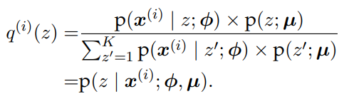
Expectation-Maximization (EM) : The E-step
The step in which we update q (i) is known as the E-step, because it updates the distribution under which the expectation is computed.

Slide 9
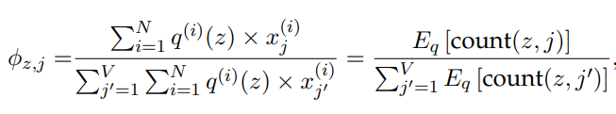

Expectation-Maximization (EM) : The M-step
Next, we hold fixed the soft assignments q (i) , and maximize with respect to the parameters, φ and µ. The parameter φ is a distribution over words for each cluster.

Slide 10
How many clusters?
So far, we have assumed that the number of clusters K is given.
Question:
How can we find the K value systematically?
Solution:
To choose the number of clusters:
To maximize a metric of clustering quality.
Akaike Information Crition.

Slide 11
Applications of expectation-maximization
Expectation-maximization is a framework for learning with missing data.
We can find EM applications on :
Word sense induction
Semi-supervised learning
Multi-component modeling

Slide 12
Semi-supervised learning
In semi-supervised learning, the learner makes use of both labeled and unlabeled data.
Expectation-maximization can be applied to the problem of semi-supervised learning, by learning from both labeled and unlabeled data in a single model.
Semi-supervised learning makes use of annotated examples, ensuring that each label y corresponds to the desired concept.
One method is by adding unlabeled examples, it is possible cover a greater fraction of the features than would appear in labeled data alone.

Slide 13
Semi-supervised learning : Multi-view learning
EM semi-supervised learning can be viewed as self-training.
In self-training, the labeled data guides the initial estimates of the classification parameters; these parameters are used to compute a label distribution over the unlabeled instances, q (i) ; the label distributions are used to update the parameters.
The risk is that self-training drifts away from the original labeled data. This problem can be ameliorated by multi-view learning.

Slide 14
Multi-view learning
Co-training is an iterative multi-view learning algorithm, in which there are separate classifiers for each view.
At each iteration, each classifier predicts labels for a subset of the unlabeled instances, using only the features available in its view.
These predictions are then used as ground truth to train the classifiers associated with the other views. If the views are truly independent, this procedure is robust to drift. Furthermore, it imposes no restrictions on the classifiers that can be used for each view.
Word-sense disambiguation is particularly suited to multi-view learning

Slide 15
Semi-supervised learning: Graph-based algorithms
Another family of approaches to semi-supervised learning begins by constructing a graph, in which pairs of instances are linked with symmetric weights ωi,j.
The goal is to use this weighted graph to propagate labels from a small set of labeled instances to larger set of unlabeled instances.

Slide 16

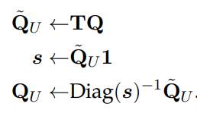
Graph-based algorithms
In label propagation, this is done through a series of matrix operations.
Let Q be a matrix of size N × K, in which each row q (i) describes labeling of instance i. When ground truth labels are available, then q(i) is an indicator vector.
Let Ti,j represent the “transition” probability of moving from node j to node i.
We compute values of Ti,j for all instances j and all unlabeled instances i, forming a matrix of size NU × N. We can then “propagate” the label distributions to the unlabeled instances.

